Slide 1
Texas Tech University Health Sciences Center
Techbuy system training
Ttuhsc purchasing

Slide 2
TechBuy System Training Agenda
Purchasing Email
Sciquest.com emails
Correct Email: purchasing@ttuhsc.edu
Purchasing website
Forms and Resources
Training Documents
Bidding and Solicitations
Bidding and Solicitations
Contract Signature Submission
Processing a TechBuy Order
Purchase Order Creation
Required attachments
Required approvals
E-Invoicing
Receipts
Questions and Answer Period

Slide 3
Purchasing Email
System Generated emails – DO NOT hit reply to system generated emails (emails that come from SciQuest). Sciquest emails are monitored by TTU staff and only one HSC staff member. Please create a new email or forward email to Purchasing@ttuhsc.edu
Please make sure to use the correct Purchasing inbox email address: Purchasing@ttuhsc.edu

Slide 4
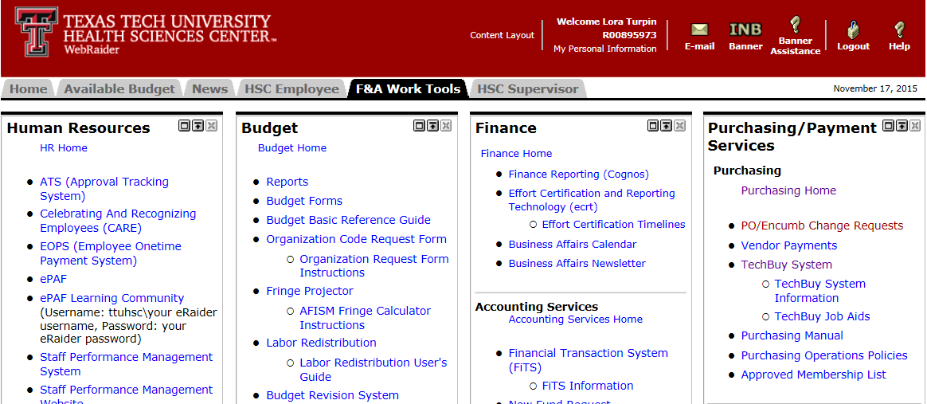
Purchasing Website
Forms and Resources
To access the Purchasing website go to the TTUHSC Webraider page. Select Purchasing Home.

Slide 5
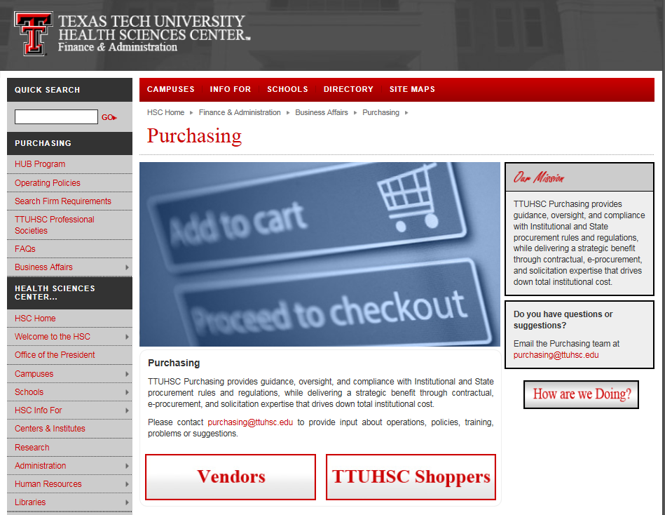
Click the TTUHSC Shoppers button.

Slide 6
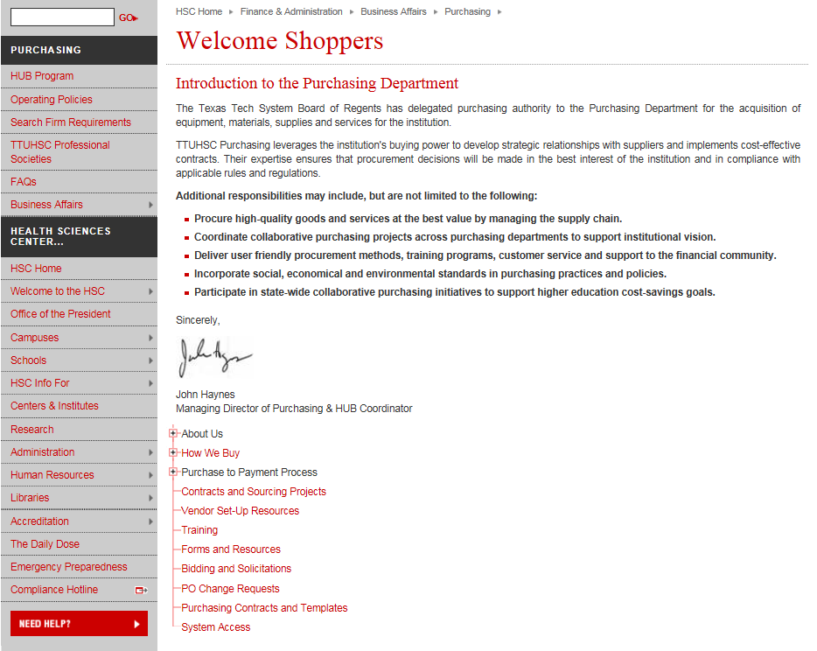
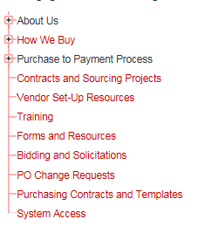
The Forms and Resources page can be accessed by clicking on Forms and Resources.

Slide 7
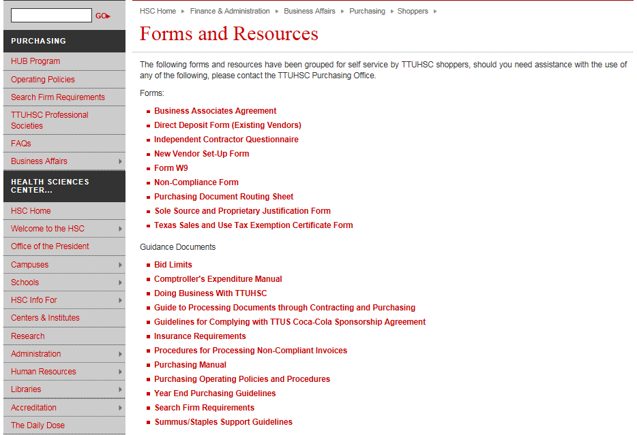
The Forms and Resources area provides access to the most recent versions of the forms, guidance documents, databases/tools, and Purchasing systems.

Slide 8
Training Documents
The Training page can be accessed by clicking on Training.

Slide 9
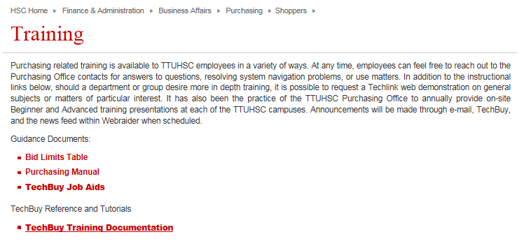
The Training area provides access to the Bid Limits Table, Purchasing Manual, TechBuy Job Aids and TechBuy Training Documentation.

Slide 10
Bidding and Solicitations
The Bidding and Solicitations page can be accessed by clicking on Bidding and Solicitations.

Slide 11
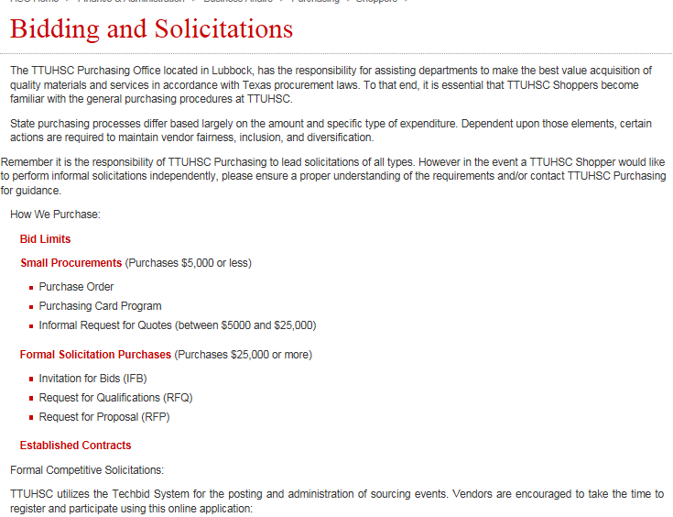
The Purchasing Department has the responsibility for assisting departments to make the best value acquisition of quality materials and services in accordance with Texas procurement laws. Click on Bid Limits for the Bid Limits Table.

Slide 12
State Purchasing processes differ based largely on the amount and specific type of expenditure.

Slide 13
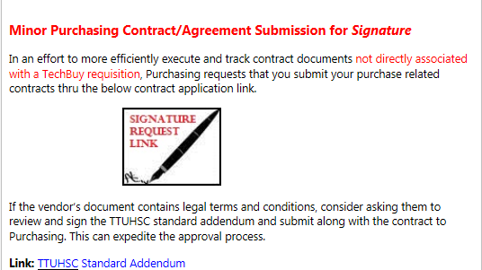
Contract Signature Submission
To submit a contract for signature that is not directly associated with a TechBuy requisition go to the TechBuy homepage. In the announcements section of the TechBuy Homespage select the Signature Request Icon.

Slide 14
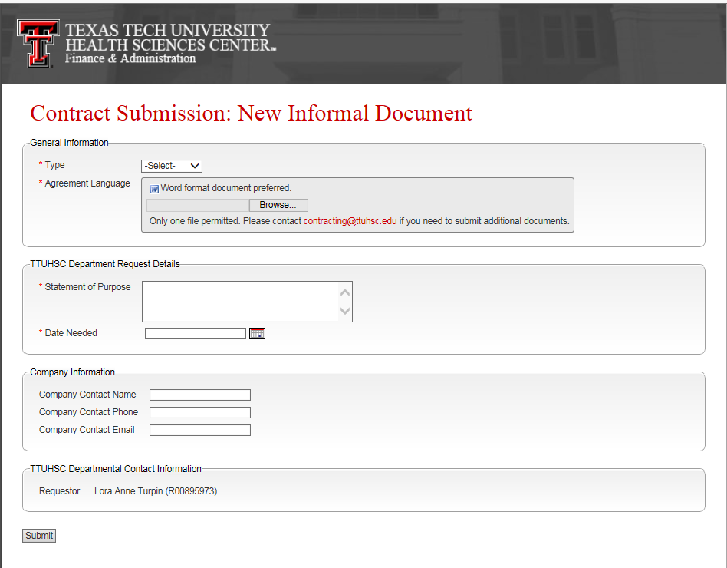
The contract submission document will appear and the fields with the * will need to be populated for submission. If you have any questions or issues please contact contracting@ttuhsc.edu

Slide 15
Processing a TechBuy Order
TechBuy Purchase Order Creation
For complete step by step instructions please access the Purchasing training documentation http://www.fiscal.ttuhsc.edu/downloads/TBM/TOC.pdf
Please see below for a general overview.
Form Orders
From the Shopping Home page select the appropriate form for the purchase (Federal Equipment Form, Employee Reimbursement Form, Non-Catalog Form or Standing Order Form).

Slide 16
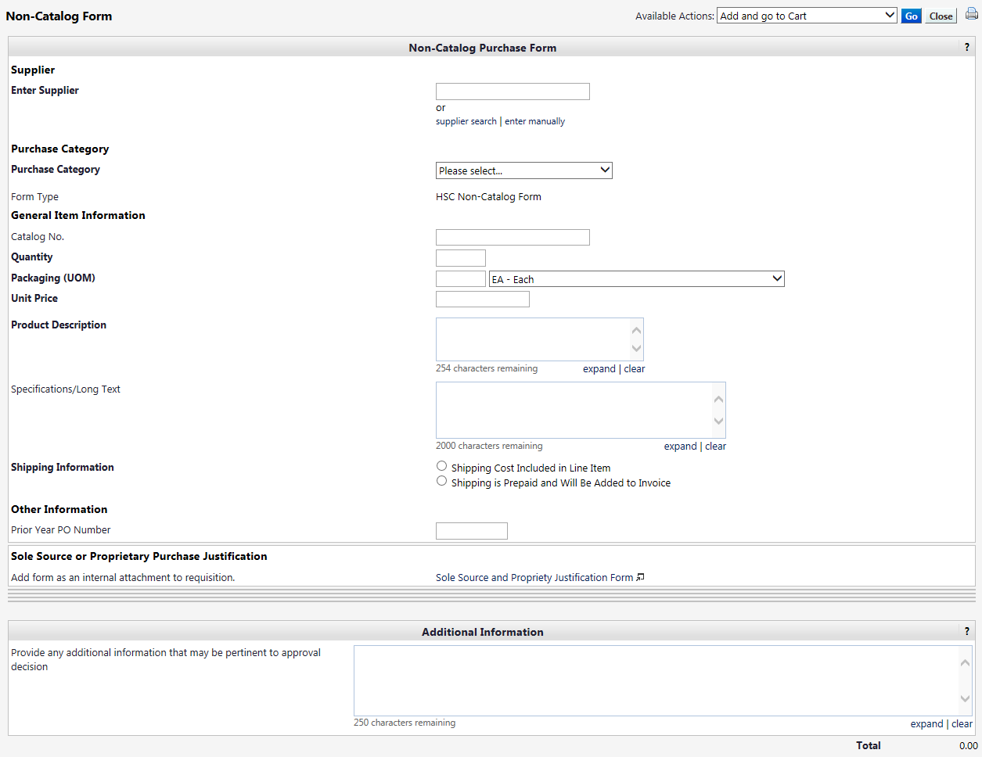
Complete the full form by filling in each field. The titles that are bolded are the required fields. When all required fields are completed select from the available actions and click go.
Select appropriate action
Click Go

Slide 17
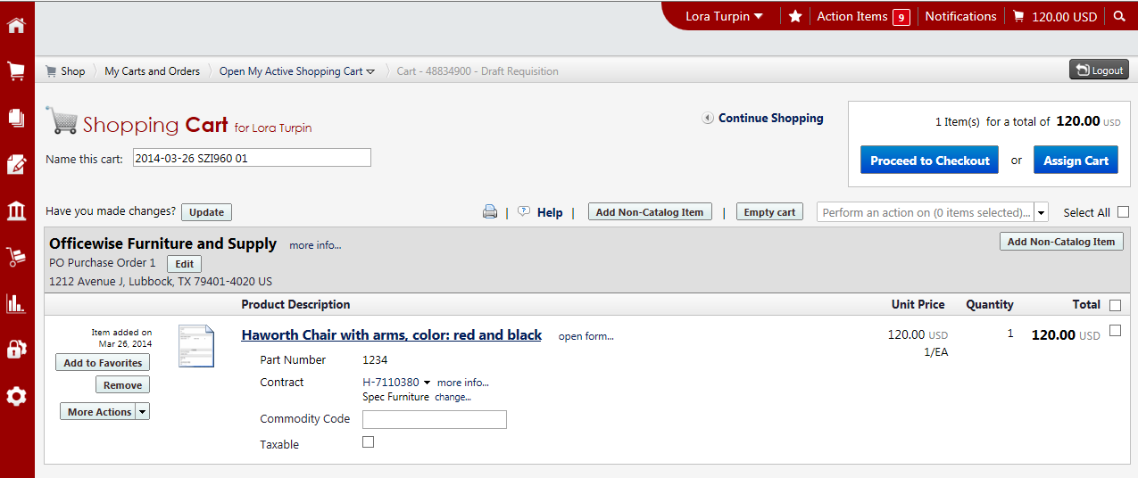
Once all line items are completed you will be taken to your cart to complete the requisition. Click Proceed to Checkout to continue to the requisition.
Click Proceed to Checkout

Slide 18
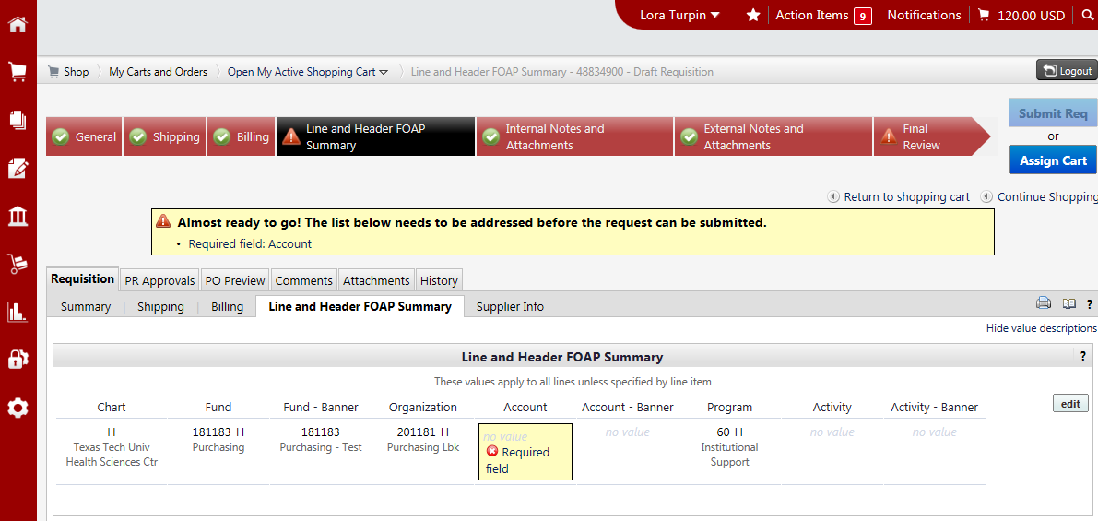
Complete all fields marked with across the top of the cart. All fields must be marked with a green check to submit the requisition. Please review all fields to verify the correct information has been entered.
All fields must be marked with a green check

Slide 19
For Recurring Payments or Advanced Pays click on the final review tab.
Final Review
Note: A state agency may not pay for goods or services before their delivery to the agency, unless the advance payment is necessary and serves a proper public purpose.

Slide 20
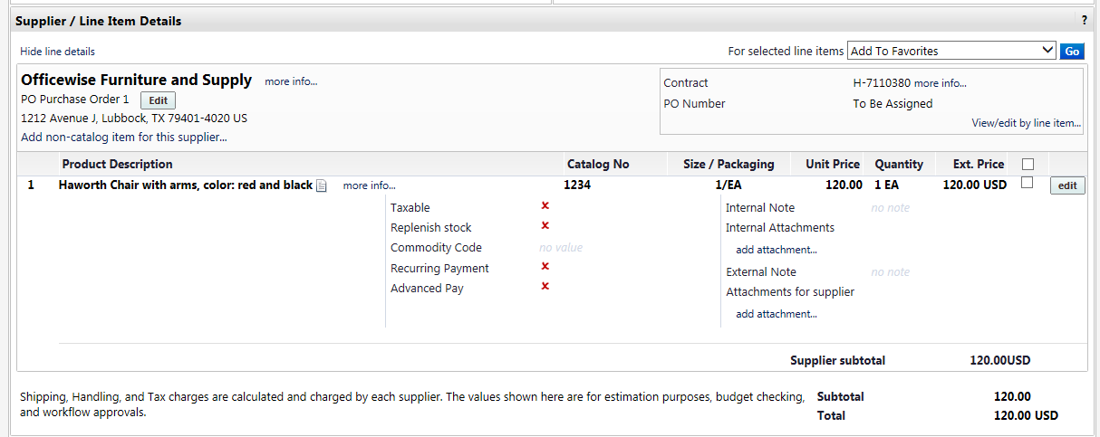
Scroll to the line item you would like to set for recurring or advanced pay. Click the edit button on each line item.
Click edit

Slide 21
Click the appropriate check box and click save.
Click appropriate box
Click Save

Slide 22
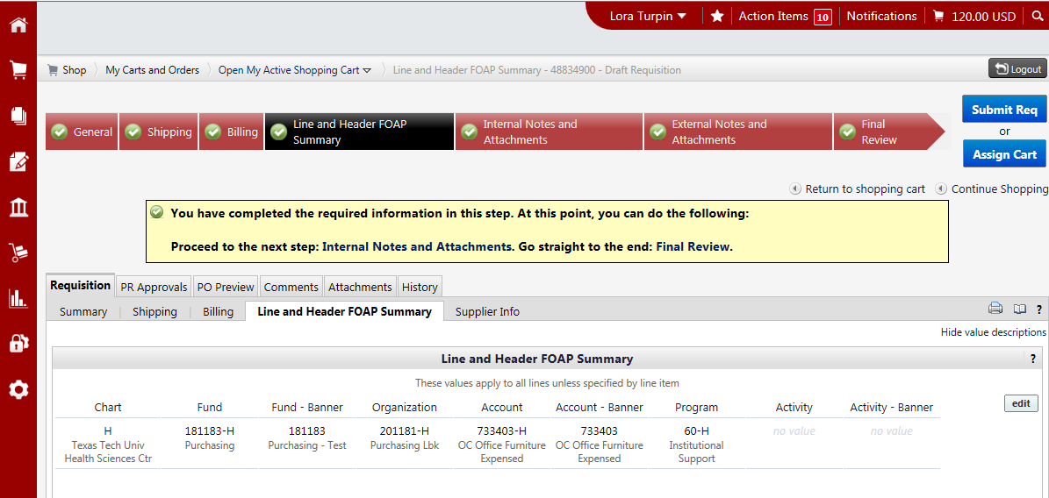
Once all fields have been reviewed and have a green check, click Submit Req or Assign Cart.
Click submit requisition or assign cart
All fields contain green checks

Slide 23
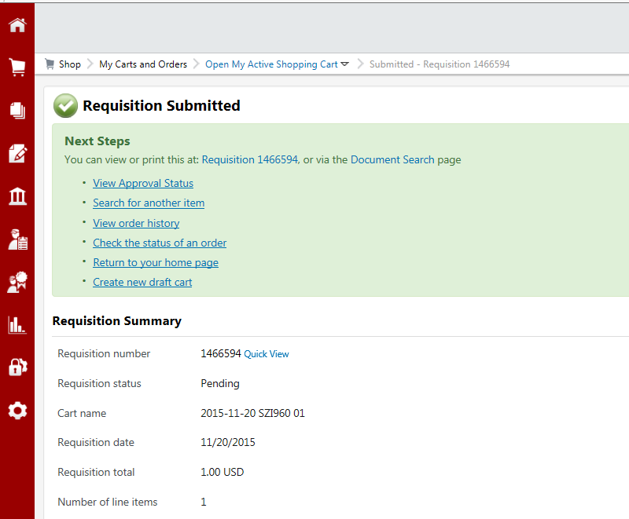
Once submitted you will receive a notification with the requisition number for your records.

Slide 24
Required Attachments
Quote – A valid quote is required to be attached on all requisitions. A quote is considered to be valid 30 days after the quote date unless an expiration date is stated.
ICQ (Independent Contractor Questionnaire) – ICQ’s must be attached to orders that an individual is providing a service to the institution.
COI (Certificate of Insurance) – A COI is required when work/labor/delivery is being provided on the institutions property.
Artwork – TTUHSC artwork (Seal, Double T, etc.) is to be attached to requisitions when being printed on items (promotional items, lab coats, etc).

Slide 25
Required Approvals
Communications and Marketing – Approval is required on all TTUHSC artwork. Please allow additional time for Purchasing to route the order to them for approval.
EH&S – Approval is required on all hazardous and radio active purchases. If the category chemicals and gases-radioactive is selected the order will be automatically routed. If not, Purchasing will request approval from EH&S and will not approve until approval is received.
Pharmaceuticals – Approval is required from Lee Easterday. If the category Pharmaceuticals is selected the order will be automatically routed. If not, Purchasing will request approval from Lee Easterday and will not approve until approval is received.

Slide 26
Receiving Receipts
The receiving receipt feature allows you to enter receiving in TechBuy. In order to maintain an order’s history, all receiving information for TechBuy purchase orders must be submitted through the TechBuy receiving process. Do not wait to receive an invoice or a request from Accounts Payable to complete “receiving” in TechBuy. Receiving should be completed when goods/services are received.
There are two types of receipts that can be entered within TechBuy:
Quantity Receipt – receipt of item(s)
Cost Receipt – receipt of service(s)
For additional information on required receiving, please review HSC OP 72.09 or call Accounts Payable 806-743-7826.

Slide 27
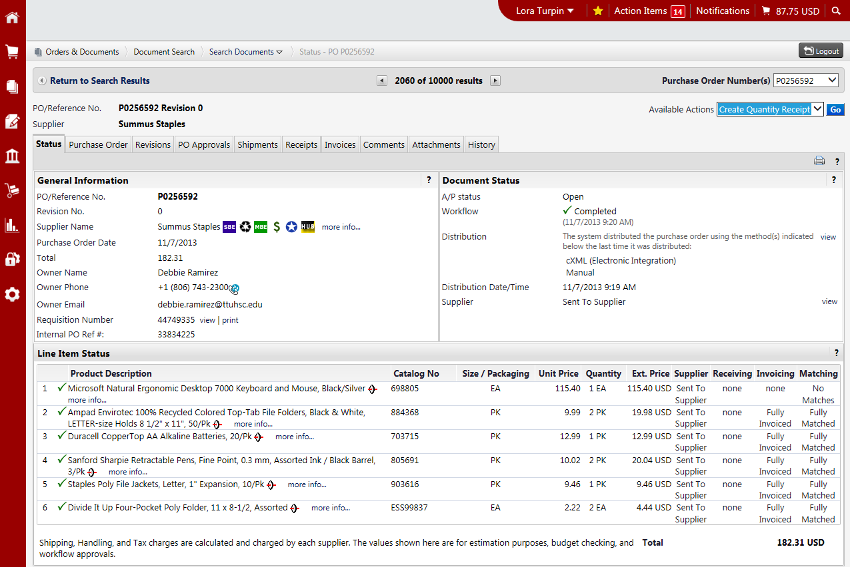
Creating a Quantity Receipt
To document the receipt of specific items, select the Create Quantity Receipt option from the Available Actions dropdown box and select Go.
Select Create Quantity Receipt
Click Go

Slide 28
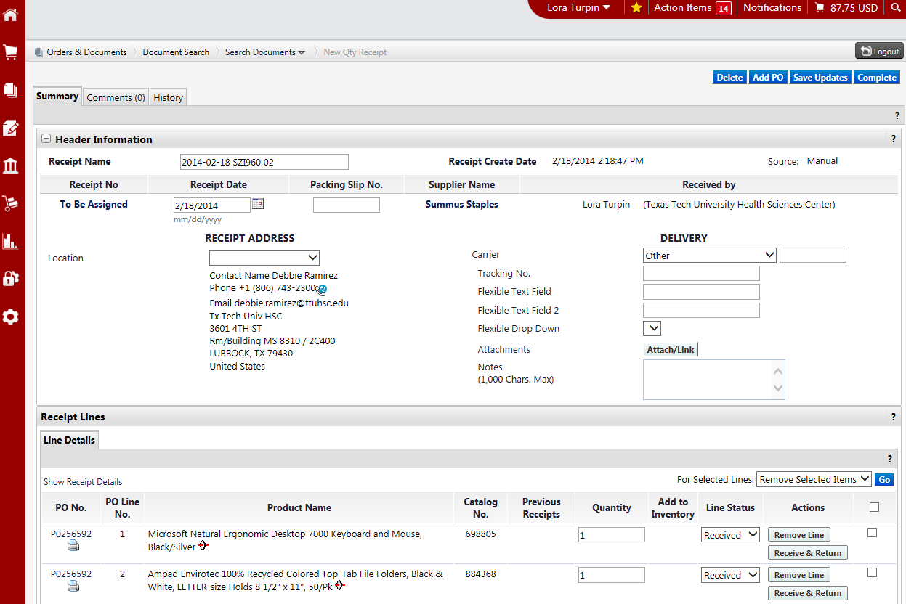
A receipt is created utilizing the information from the purchase order. It includes a header section that contains basic receiving information and a receipt summary section to enter your actual quantities received. The Receipt Summary section is where you will enter the quantity of the items received.
Header
Receipt Summary
See next page for definition of terms

Slide 29
The Quantity field will pre-populate with the remaining quantity to be received for each item. Enter the appropriate quantity. Select “line status” from the drop-down list for each item:
Received - Receive the quantity entered.
Returned - Return the quantity entered. Used only when instructed by AP because receipt cannot be reopened.
Cancelled - Do not use.
Select “Actions” for each item:
Remove Line – When creating receipts, be sure to select “remove line” for the item(s) on the PO that have not been received. Otherwise, all items will appear as received and payment will process for all items.
Received/Returned – Receive/Return the quantity entered. This is used when an item arrives and immediately returned due to damage, over shipment or any other reason. Department must follow up with vendor.
Once the receiving receipt is accurate, select Complete at the top of the page.
TechBuy will assign a receipt number to the completed document. PLEASE GIVE TIME FOR IT TO PROCESS.

Slide 30
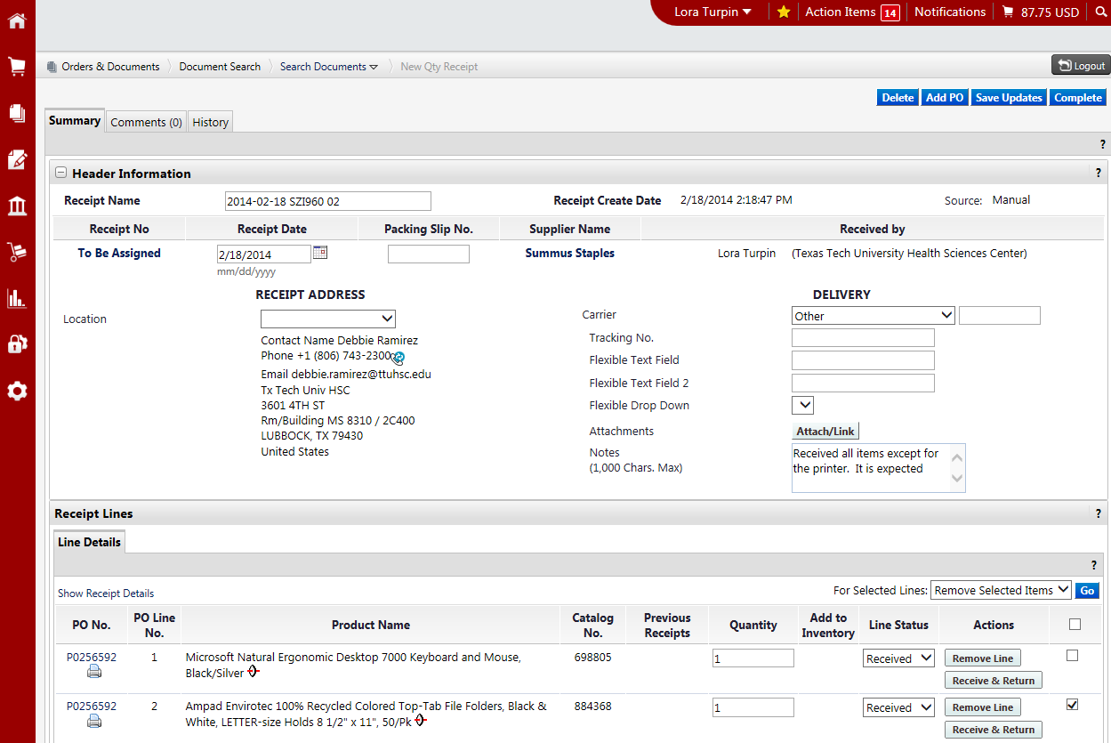
Select Complete
Very Important to enter the ACTUAL DATE the items were received.
Select when removing line(s)
Enter correct Quantity
Remember: Remove line if item is not received.

Slide 31
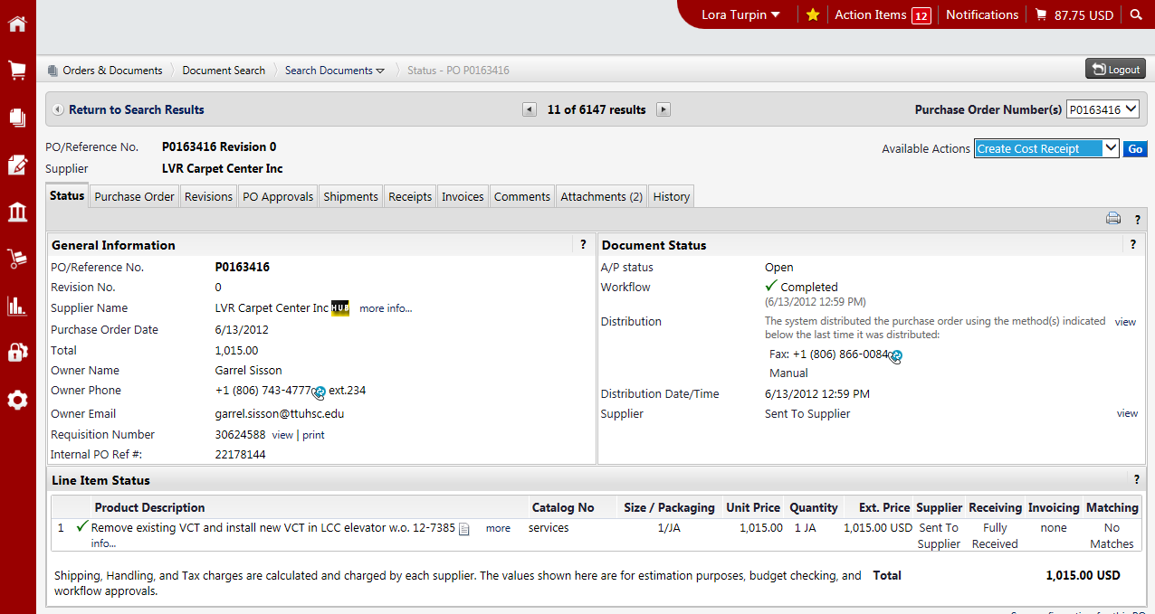
Creating a Cost Receipt
To document the receipt of services, select the Create Cost Receipt option from the Available Actions dropdown box and select Go.
Select Create Cost Receipt
Click Go

Slide 32
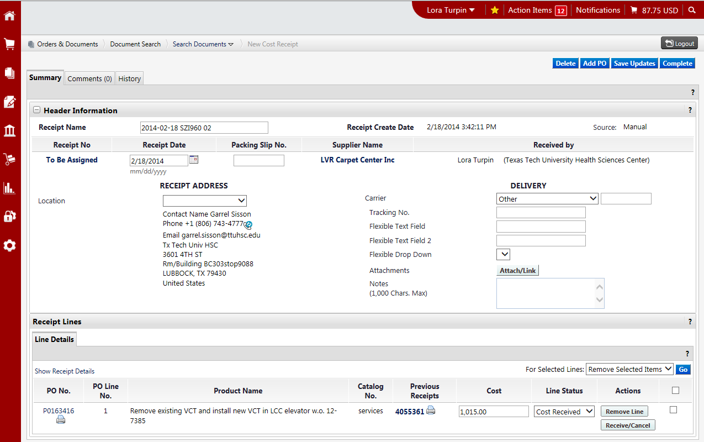
A receipt is created utilizing the information from the purchase order. It includes a header section that contains basic receiving information and a receipt summary section to enter your amount of services received.
Header
Receipt Summary
See next page for definition of terms

Slide 33
The Cost field will pre-populate with the remaining cost for each item. Enter the appropriate cost of the services received. Select “line status” from the drop down list for each item:
Cost Received - Receive the cost entered.
Cost Cancelled – Do not use.
Select “Actions” for each item:
Remove Line – When creating receipts, be sure to select “remove line” for the services(s) on the PO that have not been performed. Otherwise, all services will appear as received and payment will process for all services.
Received/Cancel – Receive/Cancel the cost entered.
Once the receiving receipt is accurate, select Complete at the top of the page.
TechBuy will assign a receipt number to the completed document. PLEASE GIVE TIME FOR IT TO PROCESS.

Slide 34
Select Complete
Very Important to enter the ACTUAL DATE the service(s) were received.
Select when removing line(s)
Enter correct Cost
Remember: Remove line if service is not performed.
For additional information on receiving please refer to TechBuy Receiving Tutorial
found at F&A Work Tools tab > Accounts Payable.

Slide 35
e-Invoicing (Electronic Invoicing)
Purchase orders are sent electronically via cXML to vendors and invoices are returned via cXML messages. Invoices are matched against the purchase order. When invoices are received in TB they are systematically matched against the order. The matching process checks every single invoice at the line item detail and determines if a price is correct or off-contract. Matched invoices are then posted to Banner for payment. The payment of this invoice will be identified on the general ledger as Banner invoice #V9xxxxxx.
Although departments are not receiving paper invoices or requests from Accounts Payable to complete receiving for invoices received in TechBuy, receiving must still be completed timely (in TechBuy) for all items received.

Slide 36
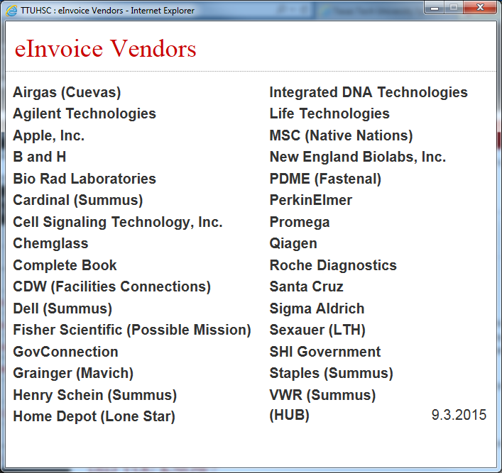
E-Invoice Vendors
HUB vendors listed in parenthesis.
Vendors in parenthesis are HUB vendors

Slide 37
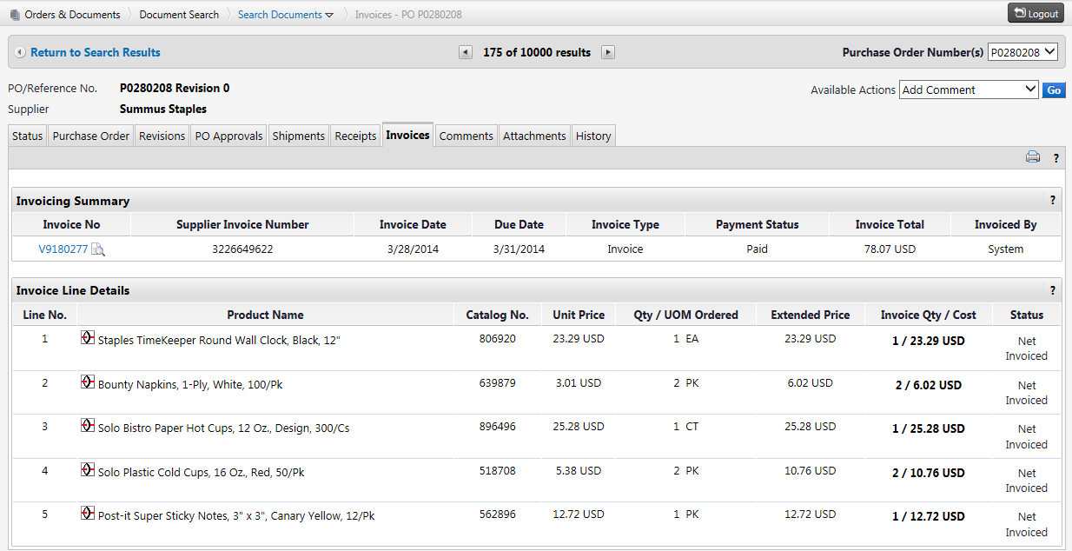
To view an invoice received electronically, select the Invoices Tab and click on the invoice number to review the invoice.
Invoices Tab
Invoice number

Slide 38
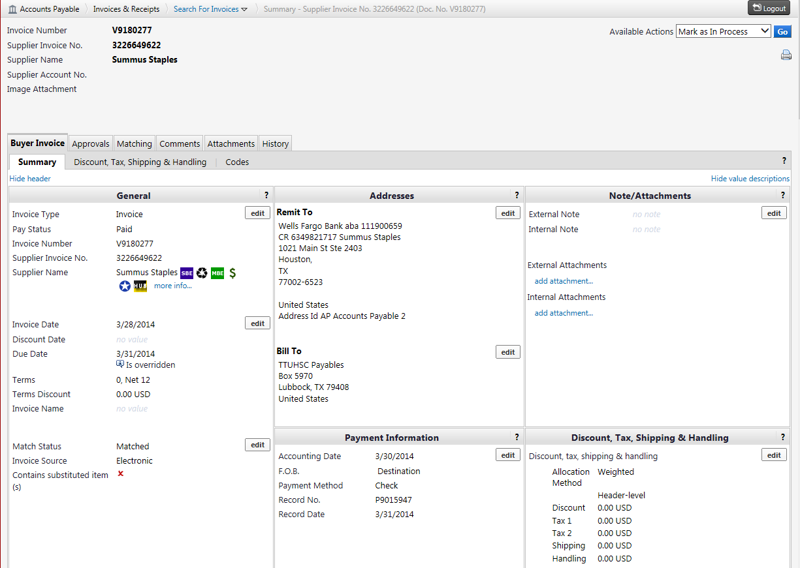
When you click on the invoice number it will pull up the invoice summary. The invoice contains useful information, such as, pay status, remit to, check number and payment date
Pay Status
Remit To
Check number
Payment Date

Slide 39
The Payment Information section of the Invoice Summary contains a record number. To identify the type of payment received please use the guide below.
Record number beginning with:
A letter indicates a State payment (Pxxxxxxx).
The number 66 indicates a local payment (66xxxxxx).
A ! Indicates a direct deposit was made (!xxxxxxx).

Slide 40
Questions ?

